Slide 1
Food
Name: Kayode Peter Temitope
Matriculation Number: 208077
Department: Computer Science (200 Level)
Course: CSC 272 (Information Management System)

Slide 2
Content
What is food?
Classes of food
Importance of food
Balanced diet
Benefits of Balanced Diet

Slide 3
What is Food?
Food is any substance consumed to provide nutritional support for an organism. Food is usually of plant, animal or fungal origin, and contains essential nutrients, such as carbohydrates, fats, proteins, vitamins, or minerals.

Slide 4
Classes of Food
There are six main classes of nutrients that the body needs which are:
Carbohydrate
Protein
Fat
Vitamin
Mineral
Water

Slide 5
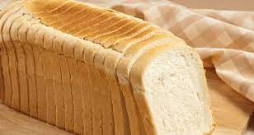
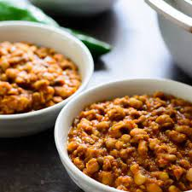
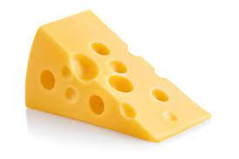
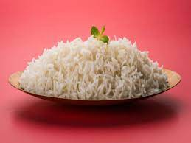
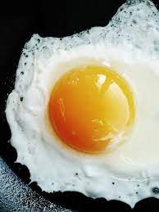
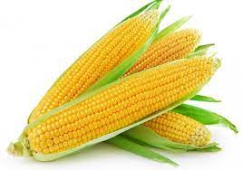
Classes of Food
Carbohydrates
Proteins
Corn
Rice
Bread
Beans
Egg
Cheese
Notes:
Carbohydrates: Carbohydrates are found in a wide array of both healthy and unhealthy foods. Examples include bread, beans, milk, popcorn, potatoes, cookies, spaghetti, soft drinks, corn, and cherry pie. They are the major class of food that supplies energy
Proteins
The class of food that majorly repairs worn out tissues

Slide 6
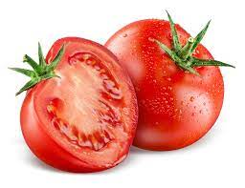
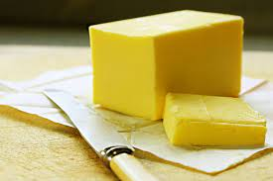
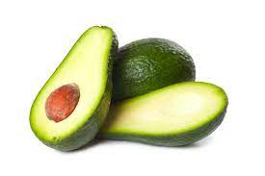
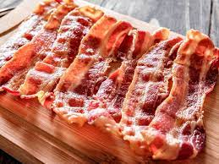
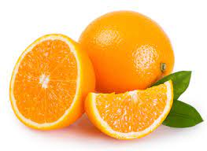
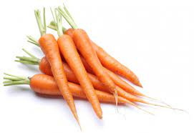
Classes of Food
Fats
Vitamins
Butter
Avocado
Pork
Orange
Tomato
Carrot
Notes:
Fats: Fats are nutrients that give you energy. Fats have 9 calories in each gram. Fats help in the absorption of fat-soluble vitamins A, D, E, and K. Fats are either saturated or unsaturated, and most foods with fat have both types.
Vitamins: Vitamins are majorly fruits and roughages that helps to free bowel movement

Slide 7
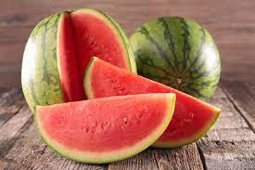

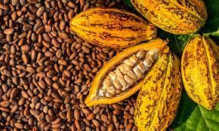
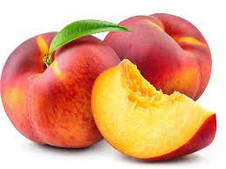
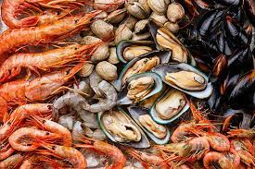
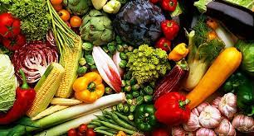
Classes of Food
Mineral
Water
Vegetables
Shellfish
Cocoa
Watermelon
Water
Peach
Notes:
Minerals: Minerals are inorganic nutrients. That is, they are materials found in foods that are essential for growth and health and do not contain the element carbon.

Slide 8
Importance of Food
The food we take in our nutrition acts as a fuel to generate energy in the mitochondria.
The food contains proteins that provide amino acids for digestion
When we feel sick, we take food and medicine to be cured and healed, if we eat sufficient food, our immunity boosts up and we feel relieved from a cough, cold-like symptoms to a recognizable extent.
Many people under stress and depression neglect food. But interestingly the same food can relieve stress and strain.

Slide 9

Balanced Diet
A balanced diet is a diet consisting of a variety of different types of food and providing adequate amounts of the nutrients necessary for good health.

Slide 10
Benefits of a Balanced Diet
Prevents diseases and infections
Helps control excess weight
Improves your mental health
Helps in improving skin and hair

Slide 11
Thank you!

